Slide 1
Modern Boiler Level Indication
“Real Time Density Corrected Level Measurement”

Slide 2
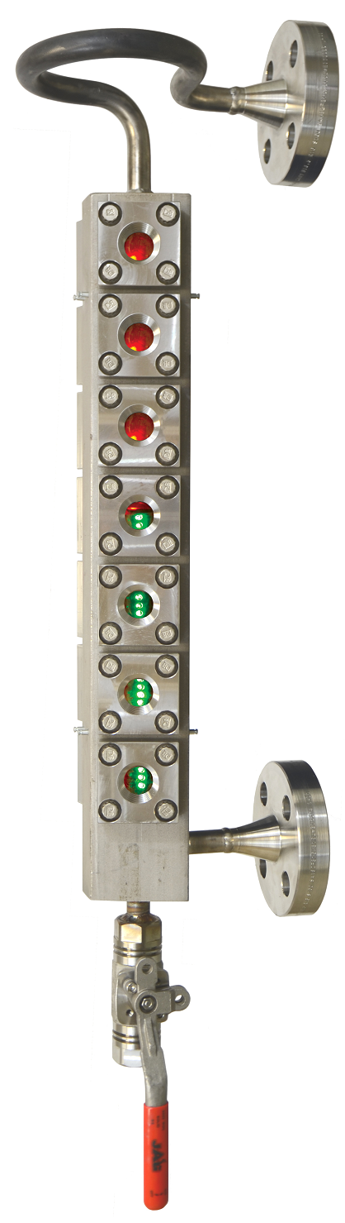
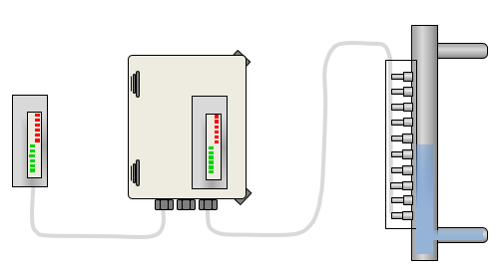
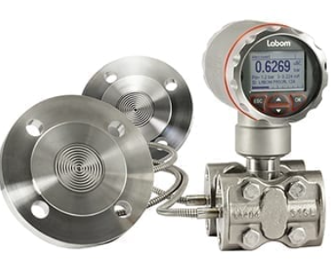
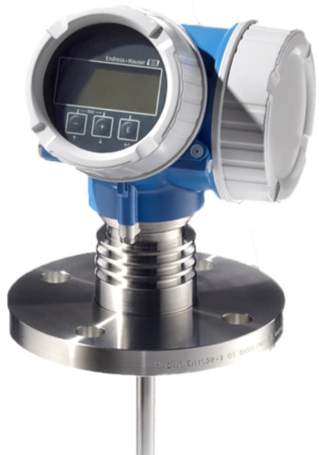
Modern Boiler Level Indication
Different Types of High-Pressure Steam, Boiler Level Indicators ?
Sight Glass
Multi-Point Probe Level Indicator
DP Transmitter
Guided Wave Radar
- Classic Reliable
- Endless Recalibration
- Widely recognized as superior
level technology
- Must have per code
- Direct Reading
- Level Verification

Slide 3
Modern Boiler Level Indication GWR v. DP
Guided Wave
Differential Pressure
Straight Forward: Reads Level by Evaluating Echo
Questtec offers a simple means of virtual, real time Temperature Compensation
Simple Mechanical Installation: Drum Connections and Drain
Virtually maintenance free
Enhanced accuracy during fill and start-up.
Infers level via calculation of Pressure Differences
Temperature compensation is resolved via a complex algorithm based on assumptions of temperature drop.
Complex system of pressurized communication piping
Frequent maintenance of piping
Relies on pressure balancing of system which slows response

Slide 4
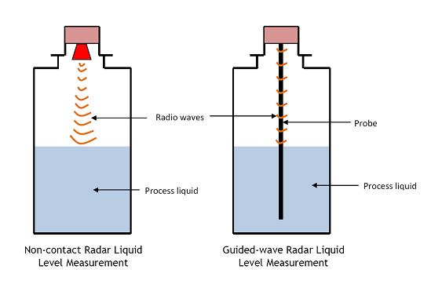
Modern Boiler Level Indication
Guided Wave Radar – Steam Drums
What is a Guided Wave
Guided Wave Radar is a highly accurate means of determining Liquid Level
Microwave Burst Tracks a SS Rod
Using Time Domain Reflectometry (TDR), Return Echo is Evaluated

Slide 5
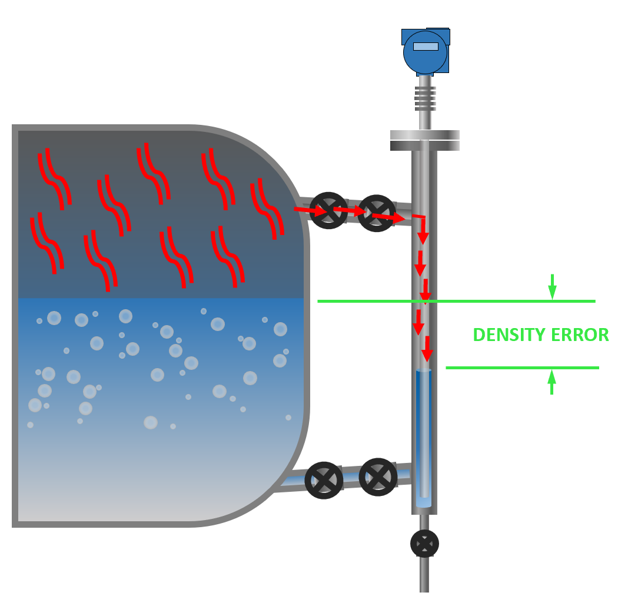
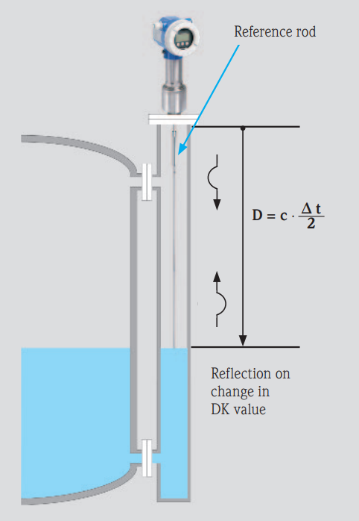
Modern Boiler Level Indication
Gas Phase Compensation vs. Density Correction

Slide 6
Guided Wave Radar – Steam Drums
What is a Gas Phase Compensation?
Microwaves Travel Slower thru Steam
Higher Pressure, Slower Speed
Known Length Reference Point Reflector
Calculates a Dynamic Compensation

Slide 7
Guided Wave Radar – Steam Drums
What is a Water Density Compensation?
The sub-cooled condensed steam in the bypass chamber is denser than the water in the drum
GWR is accurate, but will pass along an error of 5-18%, due cooler/denser water in the bypass chamber
Density Error

Slide 8
Guided Wave Radar – Steam Drums
Water Density Math
H_{d}D_{d} = H_{g}D_{g} + H_{s}D_{s}
H_{d} =
H_{g}(D_{g} - D_{s})
D_{d} - D_{s}
Density Error
H_{s}
H_{d}
H_{g}
Density = D_{s}
D_{d}

Slide 9
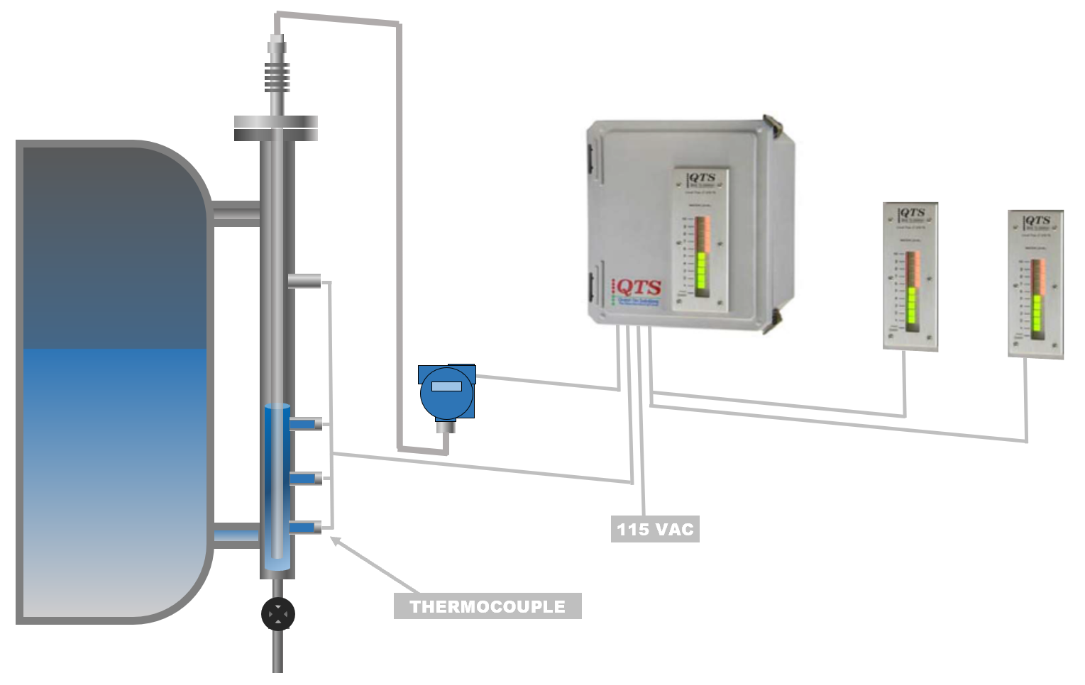
Water Density
Guided Wave Radar technology with Density Error Correction
- Real time temperature reading sent to control unit
- Density error is calculated
- Level signal is corrected
- Accuracy is improved
DENSITY ERROR

Slide 10
Modern Boiler Level Indication
What Challenges Exist In High Pressure Steam Service, When Measuring Water Level?
3
2
Condensate Flow
What is the Error Potential?
1
Pressure | Temperature | Column Range | *Density Error % | *Density Error “inches” of H2O
2000 psi | 636 F | 60” | 8% | 4”
2500 psi | 669 F | 60” | 12% | 7”
3000 psi | 696 F | 60” | 27% | 18”
4
*Numbers are rounded up.

Slide 11
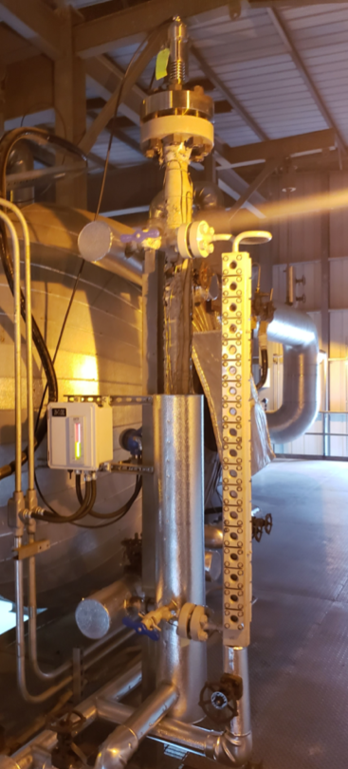
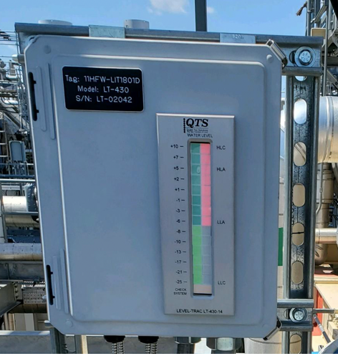
Field Installation
Field Proven Approach
Duke Buck Steam Station
Duke Dan River
Sugar Creek Generating Station
Duke - Asheville
Alliant Riverside
NAES Newark Energy Center
Alliant Marshalltown
Duke – Tiger Bay
Duke Hines Energy Complex
Covert Generating Station
BP Whiting Clean Energy

Slide 12
Guided Wave Radar – Steam Drums
Presentation By: Questtec Solutions, Houston Texas
Always Use Coaxial Probe
XXX
Bare Probe
Coax Probe
Wave will ignore irregularities on the column wall.
Cost is nominal for the benefit.

Slide 13

The Questtec Advantage
Why Questtec
Questtec Specializes in the Steam Drum Level Indication – Over 10 years Experience with successful HP Steam Drum Applications
Questtec fully understands and compensates for Water Density Error
Questtec products are designed for ease of installation/integration
Questtec is dedicated the high level of personal service your operation requires
Questtec stocks all long lead time items (including complete HP Guided Wave probes and electronics) and will keep your plant running
Questtec is THE quality supplier of Steam Drum Water Level Indication equipment
Direct Reading Sight Glasses
Conductivity/Resistivity Remote Level Indicators
Fully integrated Guided Wave Radar systems.
S Stamp. The ASME stamp allows manufacturers to fabricate ASME-compliant pressure retaining parts, power boilers, and power piping. Like the U and U2 stamps, it requires a quality assurance program that meets the standards outlined in the ASME Boiler and Pressure Vessel Code.
QUESTTEC SOLUTIONS IS AN ASME CODE STAMP HOLDER, S, R, U

